Slide 1

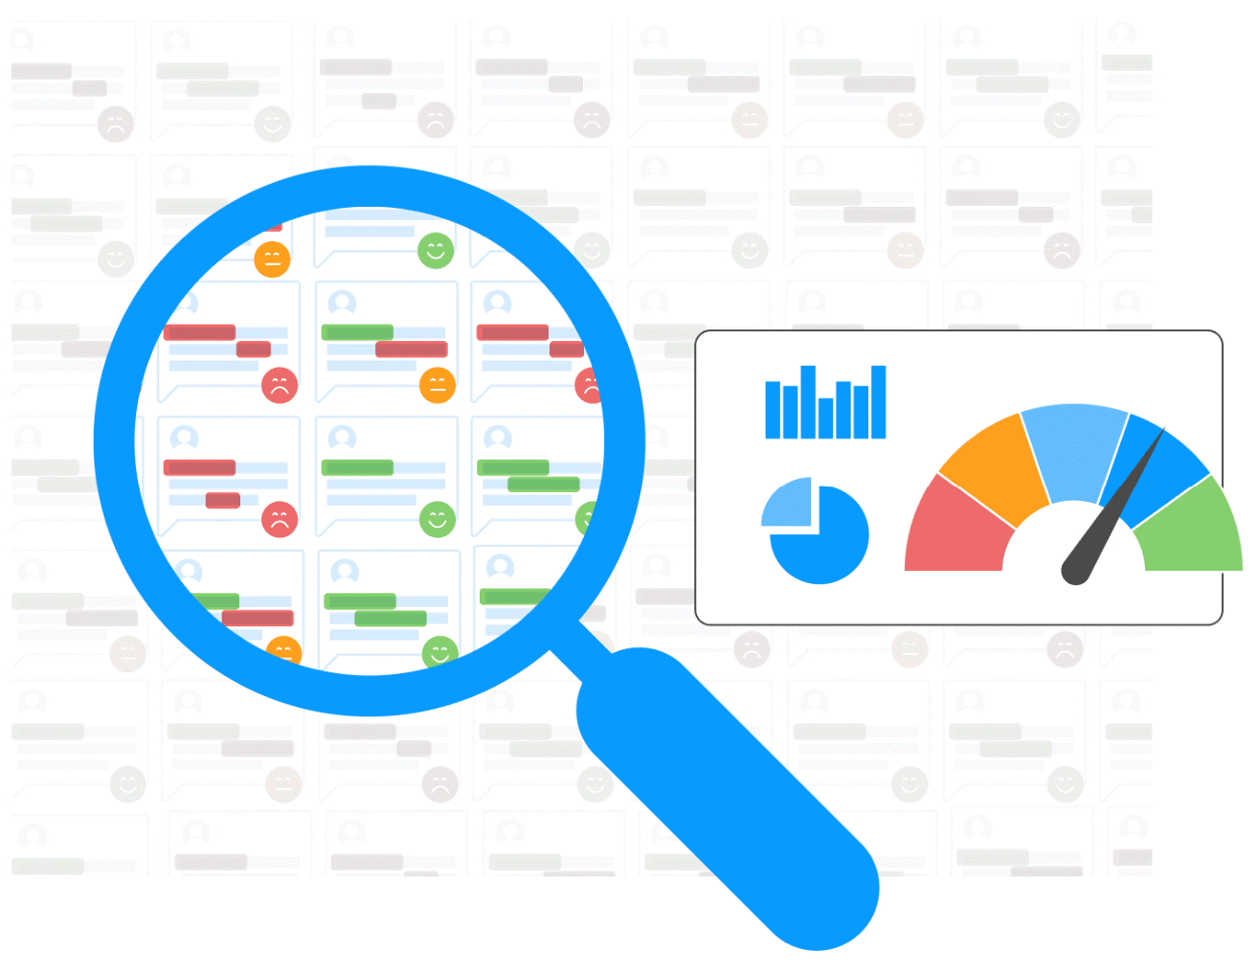
Aspect Based Product Review Mining
Group No. 9
A system to rate and rank different features of a product based on the customer reviews
Members:
Bhaswanth Gudimella, MT22025
Kushagra Mittal, MT22108
Vamshi Krishna Vannekala, MT22086
Vaibhav Nauriyal, MT22129
Ujjwal Garg, MT22085
Shreeyash Khalate, MT22069

Slide 2
Overview
Problem Definition
Motivation & Challenges
Related Work & Limitations
Proposed Solution
Proposed Methodology
Proposed System
Novelty
Web Interface
Impact
Results and Evaluation
Conclusion
The goal of our proposed system
is to provide more detailed
evaluation of a product’s
performance with respect to its
different features based on Amazon customer reviews

Slide 3
Problem Definition
Develop a system to analyze customer reviews of Amazon products, extract different aspects mentioned in reviews (quality, design, usability, durability, etc.), retrieve opinion reviews for each aspect, calculate a rating for each aspect of each product, and rank products based on those aspects.

Slide 4
Motivation
To Improve Customer Satisfaction: The overall review of a particular product often leads to customer dissatisfaction and does not portray a better picture of product in terms of quality.
Product Evaluation at Granular Level: Often customers want to focus on one or two particular features of a product rather than considering the overall rating of that product.
Improved Decision Making: Help customers choose a product that serves their needs better.

Slide 5
Challenges
Dynamic Extraction of Aspects. Bigrams like “battery life”, “camera quality” are tricky to detect and bigrams does not always give complete picture.
Not all Aspects are unigram or bigram words.
Presence of inversion words. For example, “not so good camera”.
Absence of all the Aspects in the customer reviews.
Presence of biased reviews.

Slide 6
Related Work and Methods
Based on available literature there are 3 primary methodologies in Aspect Based Opinion Mining:
1.Vocabulary-based approaches:
Rely on pre-defined sentiment lexicons or dictionaries. simple and computationally efficient, but cannot capture nuances in text like sarcasm, irony, etc.
2.Machine learning-based approaches:
Supervised or unsupervised machine learning algorithms to automatically learn the sentiment polarity of opinions expressed towards specific aspects. Require a large amount of labelled data
3.Hybrid approaches:
Combination of both vocabulary-based and machine learning-based approaches to improve the accuracy of sentiment analysis

Slide 7
Related Work and Methods
LDA:
•LDA is a topic modeling technique used to identify topics in a set of documents. "Sentic LDA" is a novel technique that combines LDA with SenticNet to improve sentiment analysis for aspect-based analysis. It was evaluated on three benchmark datasets and achieved high F1-scores.
•Sentic LDA was evaluated on three benchmark datasets, SemEval 2014, SemEval 2015, and SemEval 2016 and it achieved an F1-score of 79.33%, 73.98%, and 67.75% respectively.
BERT:
•The paper "Target-Dependent Sentiment Classification With BERT" introduces BERT, a pre-training technique for language representation models. The fine-tuned BERT model was pre-trained on SemEval-2014 Task 4 dataset and achieved an F1 Score of 81.4%, outperforming traditional methods.

Slide 8
Related Work and Methods
OPINE:
•OPINE is an Opinion Inference Engine proposed for extracting product features and opinions from online reviews. It uses a statistical approach based on PMI to identify sentiments expressed towards features. OPINE outperforms traditional vocabulary-based approaches, achieving F1-scores of 77.7% and 75.3% on two datasets of digital camera and hotel reviews, respectively.
Lexicon Based Approaches:
•A traditional method with a pre-defined sentiment lexicon or dictionary to determine the sentiment polarity of the words or phrases related to a particular aspect in a text [1]
•Contains a Bag of Words with their corresponding polarities called as lexicon [1]

Slide 9
Limitations
Limited Data Availability
Bias in Customer Reviews
Complexity of Natural Language
Lack of appropriate model
Computationally expensive

Slide 10
Proposed Solution
Irrelevant words are removed and the text is normalized.
The aspects are extracted from the preprocessed data.
Perform sentiment analysis on each review with respect to each aspect using supervised machine learning algorithms or lexicon-based approaches.
Rating score of each aspect is then calculated.
The aspects are then ranked based on their rating scores to identify the most relevant aspects of a particular product.

Slide 11
Proposed Methodology
Data Collection: Collect customer reviews from Amazon.
Data Pre-processing: Clean and group reviews by product or category.
Aspect Extraction: Use NLP techniques to identify different aspects mentioned in reviews.
Opinion Extraction: Use sentiment analysis to extract corresponding opinions/ratings for each aspect.
Rating Calculation: Calculate an overall rating for each aspect by aggregating sentiment scores.
Ranking: Rank products based on their ratings for each aspect.

Slide 12
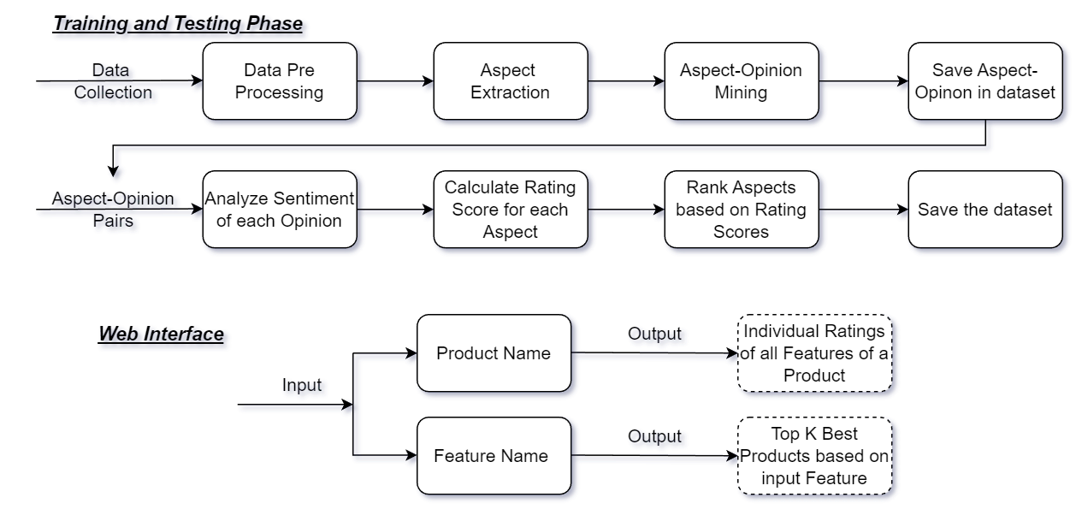
Proposed System

Slide 13
Novelty
Product Ranking based on Individual Features: Online product reviews often lack details on individual features. The proposed system can extract users' opinions on each aspect from generic reviews and rank products accordingly.
Focus on Specific Features: We will be able to analyze customer reviews to extract aspects that are most important to customers thus focusing on specific aspects of a product.
Dynamic Aspect Extraction: Dynamic aspect extraction using machine learning algorithms like topic modeling improves accuracy without relying on predefined lists of product aspects.
In-Depth Feature-Level Analysis of a Product: Aspect-based product ranking reveals detailed strengths and weaknesses from customer reviews, benefiting both customers and manufacturers.

Slide 14
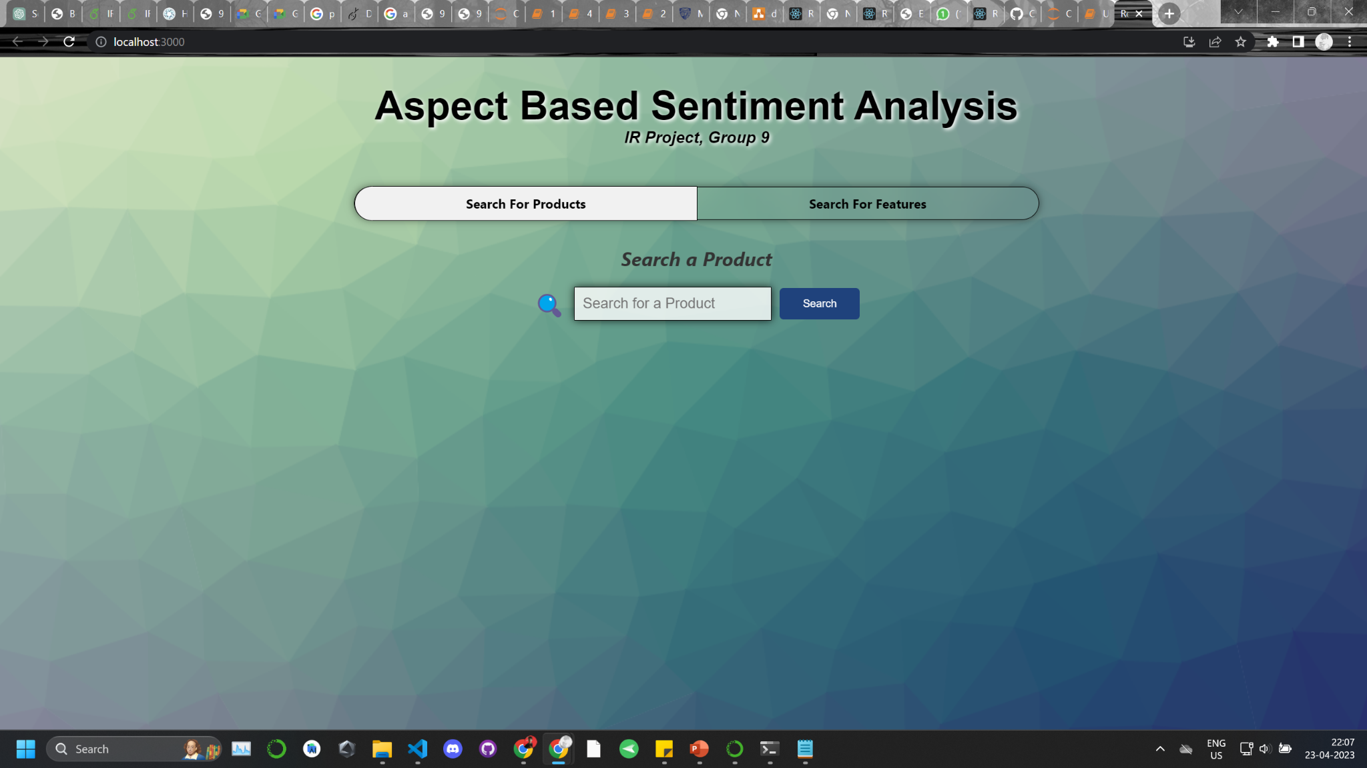

Slide 15
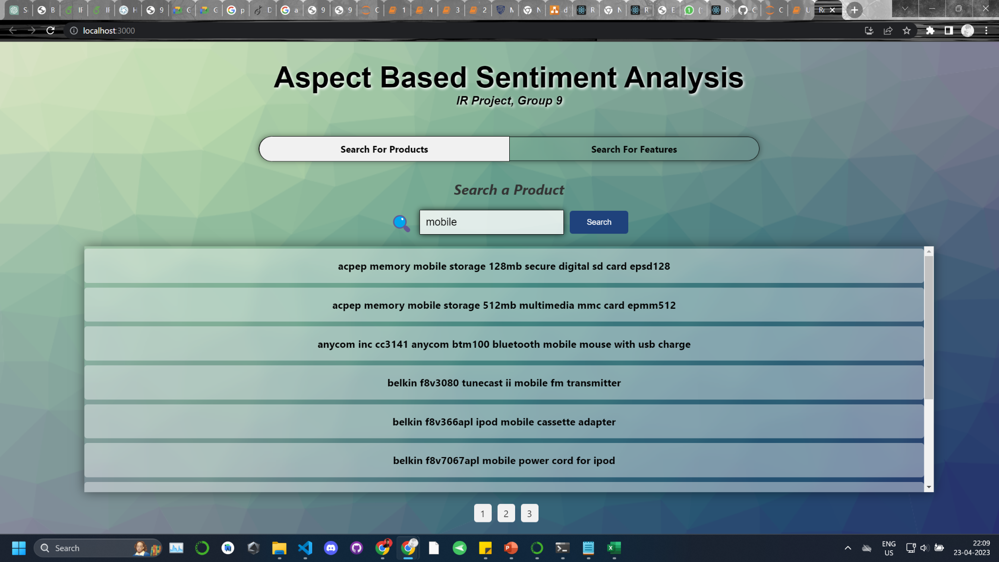

Slide 16
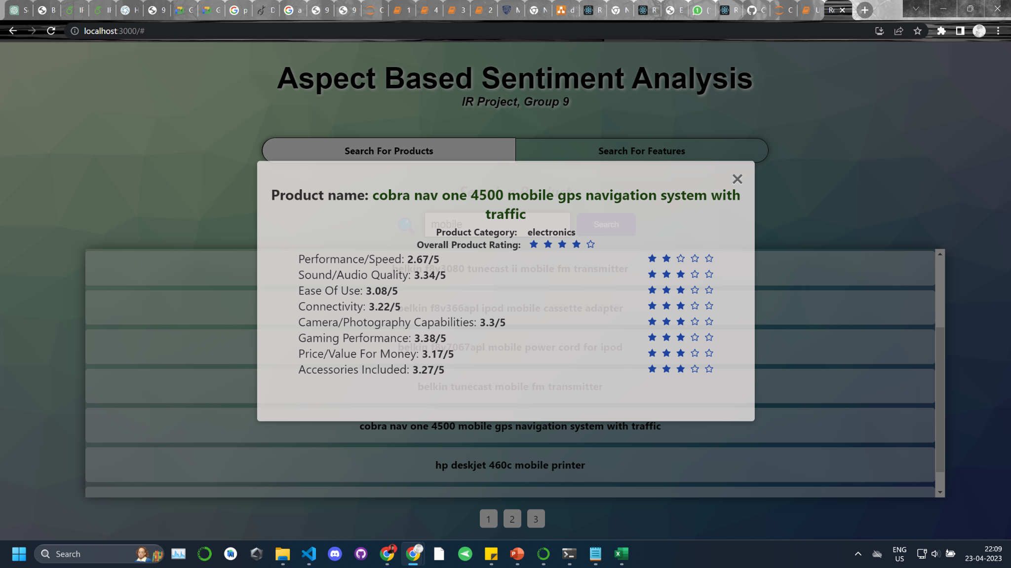

Slide 17
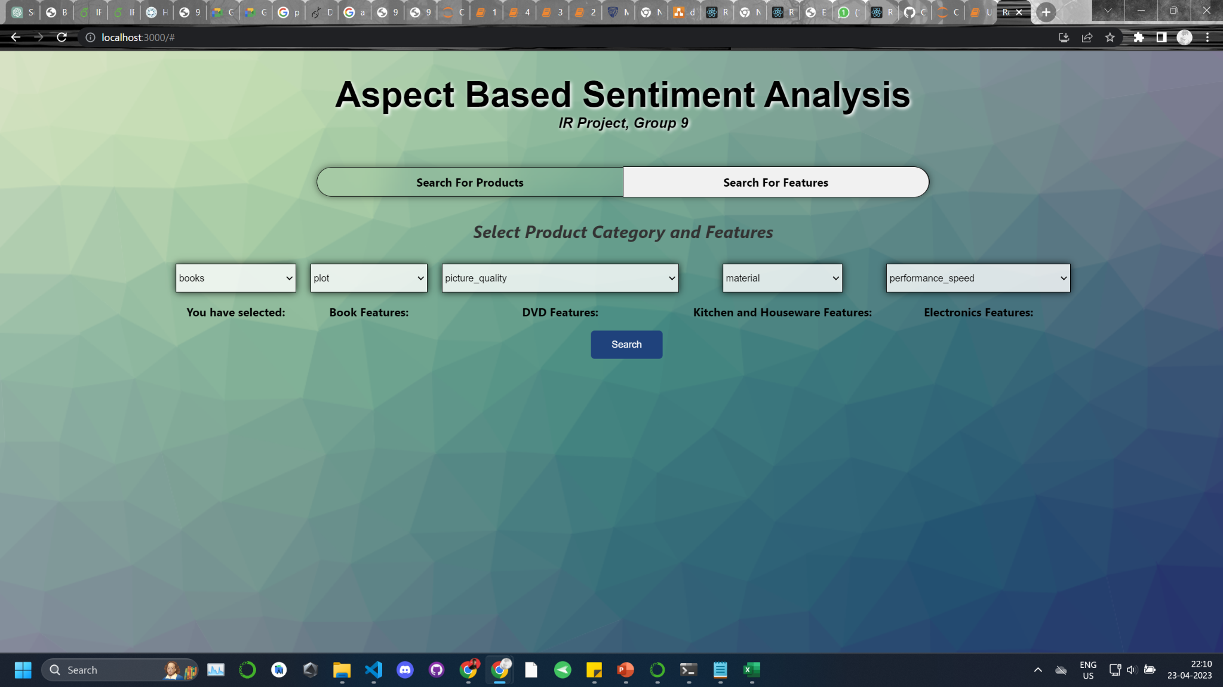

Slide 18
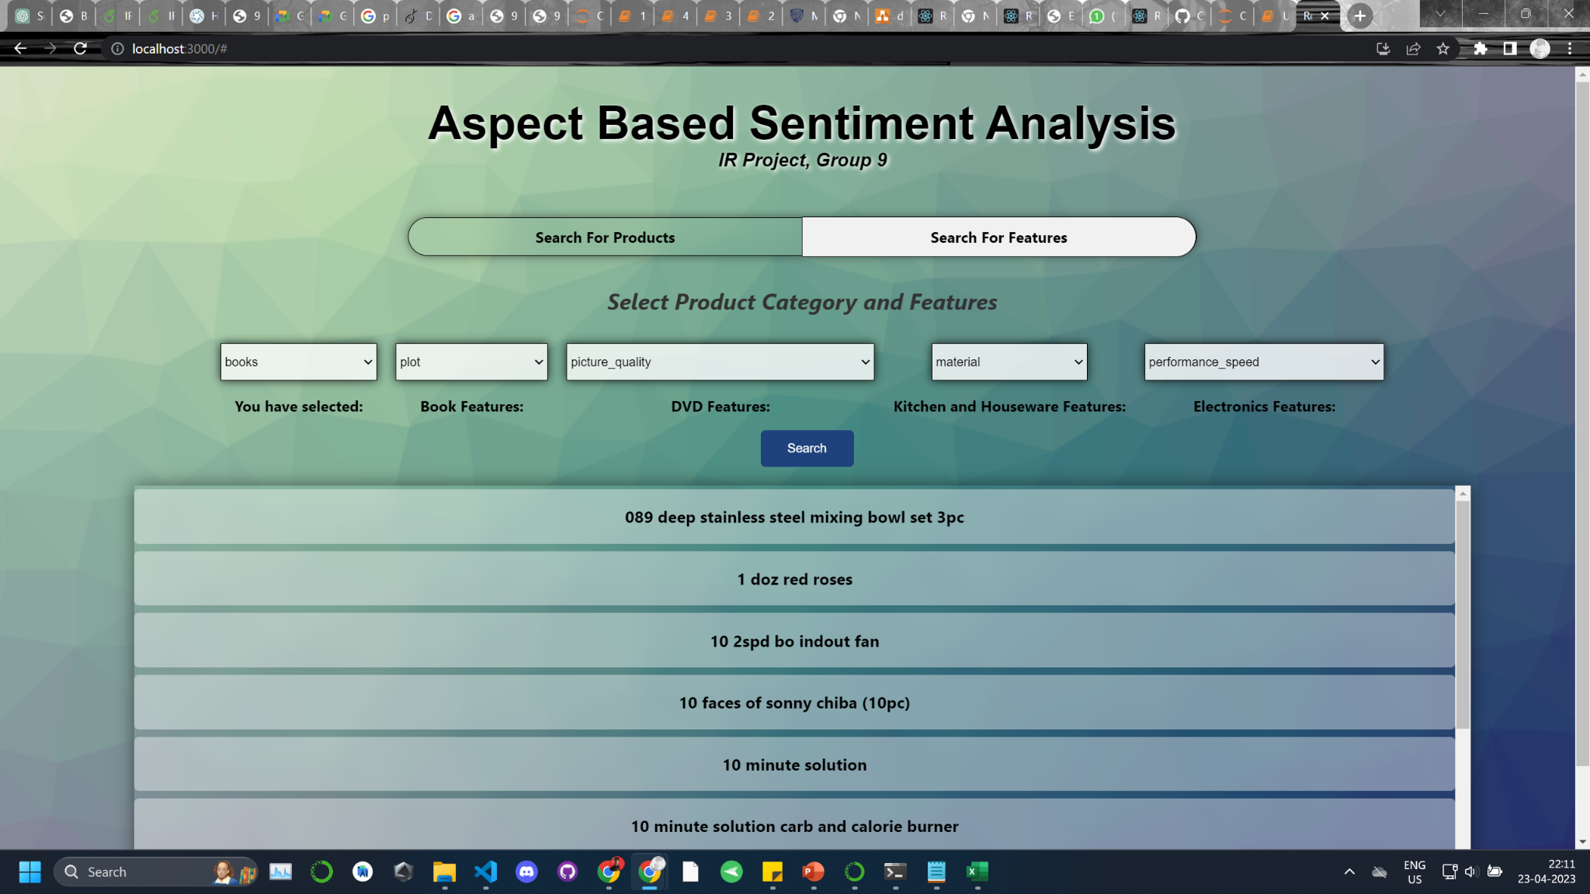

Slide 19
Impact
1. Customer Satisfaction and Improved User Experience : Reviews can lead to customer dissatisfaction and don't always reflect a product's quality. To improve the user experience, a proposed system will offer more in-depth analysis of the product.
2. Enhanced Product Evaluation: Customers prioritize specific product features over overall quality. By rating and ranking each feature, it's possible to determine its individual performance and quality.
3. Real-world application: Practical application of aspect-based ranking models can benefit ecommerce websites like Amazon by enabling customers to compare products based on different features.

Slide 20
Results and Evaluation
Accuracy for new rating calculated compared to original rating is 65%Although accuracy is a subjective measure here but still can be improved further by excluding extracted aspects which do not correspond to the product quality. Furthermore, neural networks can be used to extract more accurate aspects and their opinions. We were successful in extracting the aspects and their corresponding adjectives in the review text.
All the negated words in the text were handled. We were able to eliminate all adverbs and relative pronouns and were able to join related nouns in the sentence. To improve the accuracy we detected the contradicting rating-review pairs where the rating is excellent but the submitted review is negative or vice-versa. The updated accuracy for the same data is 95.38%The BERT model was also used to extract aspects and their sentiments and gave the same accuracy as NLTK POS tagging technique which is 95.38%

Slide 21
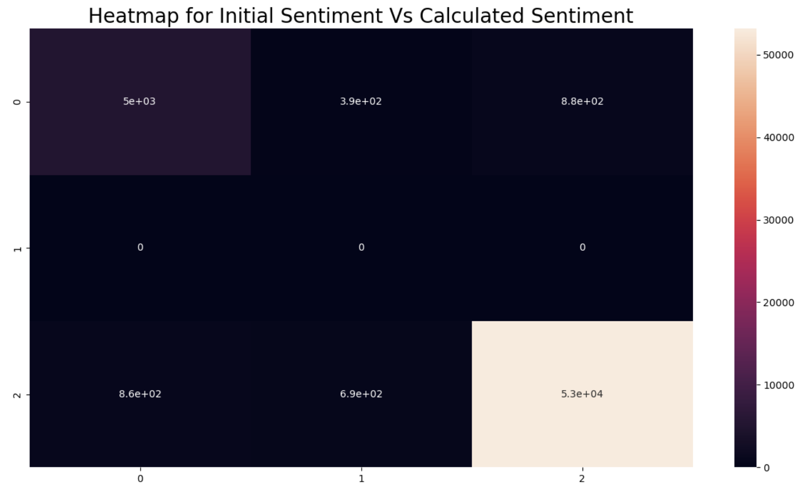
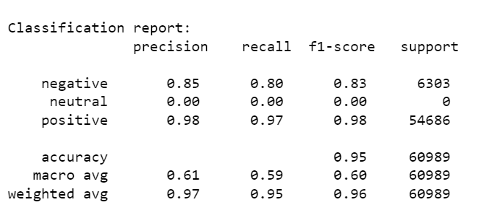
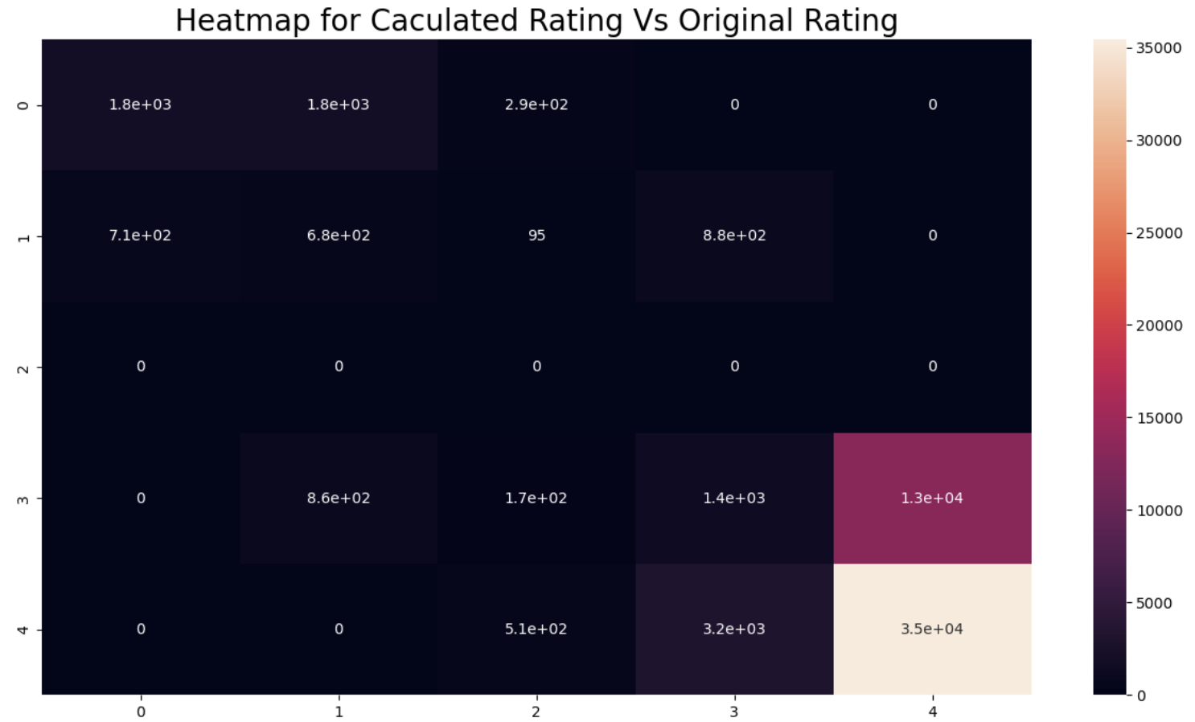
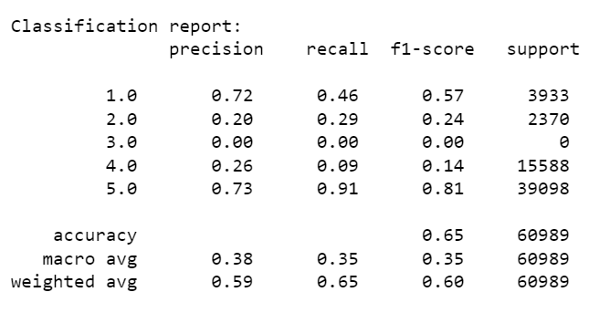

Slide 22
Conclusion
The proposed system is designed to extract every aspect of a product and calculate its rating by analyzing opinions from reviews. The idea of extracting all aspects from a customer review might not result in accurate extraction of all product related features.
By ranking each feature of the product based on its rating, the system can provide a more detailed evaluation of a product's performance in terms of specific features. This can help users make informed purchasing decisions. Our information retrieval system can return the top k products for a particular aspect specified by the user, or retrieve all aspect scores for a specific product. In this way, users can gain actionable insights for making better purchasing decisions.

Slide 23
References
[1] E. Cambria, “Affective Computing and Sentiment Analysis,” IEEE Intelligent Systems, vol. 31, no. 2, pp. 102–107, Mar. 2016, doi: 10.1109/MIS.2016.31.
[2] J. Zhou, J. X. Huang, Q. Chen, Q. V. Hu, T. Wang, and L. He, “Deep Learning for Aspect-Level Sentiment Classification: Survey, Vision, and Challenges,” IEEE Access, vol. 7, pp. 78454–78483, 2019, doi: 10.1109/ACCESS.2019.2920075.
[3] J. Zhu, H. Wang, M. Zhu, B. K. Tsou, and M. Ma, “Aspect-Based Opinion Polling from Customer Reviews,” IEEE Transactions on Affective Computing, vol. 2, no. 1, pp. 37–49, Jan. 2011, doi: 10.1109/T-AFFC.2011.2.
[4] J. Zeng, X. Ma, and K. Zhou, “Enhancing Attention-Based LSTM With Position Context for Aspect-Level Sentiment Classification,” IEEE Access, vol. 7, pp. 20462–20471, 2019, doi: 10.1109/ACCESS.2019.2893806.
[5] L. H. Son, A. Kumar, S. R. Sangwan, A. Arora, A. Nayyar, and M. Abdel-Basset, “Sarcasm Detection Using Soft Attention-Based Bidirectional Long Short-Term Memory Model With Convolution Network,” IEEE Access, vol. 7, pp. 23319–23328, 2019, doi: 10.1109/ACCESS.2019.2899260.
[6] S. Poria, I. Chaturvedi, E. Cambria, and F. Bisio, “Sentic LDA: Improving on LDA with semantic similarity for aspect-based sentiment analysis,” in 2016 International Joint Conference on Neural Networks (IJCNN), Jul. 2016, pp. 4465–4473. doi:10.1109/IJCNN.2016.7727784.

Slide 24
References
[7] A.-M. Popescu and O. Etzioni, “Extracting Product Features and Opinions from Reviews”.
[8] Z. Kastrati, A. S. Imran, and A. Kurti, “Weakly Supervised Framework for Aspect-Based Sentiment Analysis on Students’ Reviews of MOOCs,” IEEE Access, vol. 8, pp. 106799–106810, 2020, doi: 10.1109/ACCESS.2020.3000739.
[9] A. Jeyapriya and C. S. K. Selvi, “Extracting aspects and mining opinions in product reviews using supervised learning algorithm,” in 2015 2nd International Conference on Electronics and Communication Systems (ICECS), Feb. 2015, pp. 548–552. doi: 10.1109/ECS.2015.7124967.
[10] A. Ghose and P. G. Ipeirotis, “Estimating the Helpfulness and Economic Impact of Product Reviews: Mining Text and Reviewer Characteristics,” IEEE Transactions on Knowledge and Data Engineering, vol. 23, no. 10, pp. 1498–1512, Oct. 2011, doi: 10.1109/TKDE.2010.188.
[11] Z. Gao, A. Feng, X. Song, and X. Wu, “Target-Dependent Sentiment Classification With BERT,” IEEE Access, vol. 7, pp. 154290–154299, 2019, doi: 10.1109/ACCESS.2019.2946594.
[12] W. Che, Y. Zhao, H. Guo, Z. Su, and T. Liu, “Sentence Compression for Aspect-Based Sentiment Analysis,” IEEE/ACM Transactions on Audio, Speech, and Language Processing, vol. 23, no. 12, pp. 2111–2124, Dec. 2015, doi: 10.1109/TASLP.2015.2443982.

Slide 25
THANK YOU!!

